Slide 1

Online Central Records System
The General Manager’s Guide

Slide 2
The Records Officer Functions
The Office of the General Manager (OGM) has only one additional tab/function apart from the ordinary main page of any Division
Here we are shown all Documents that have been labeled as GM-secured, or needing approval of the GM. The process is as follows:

Slide 3
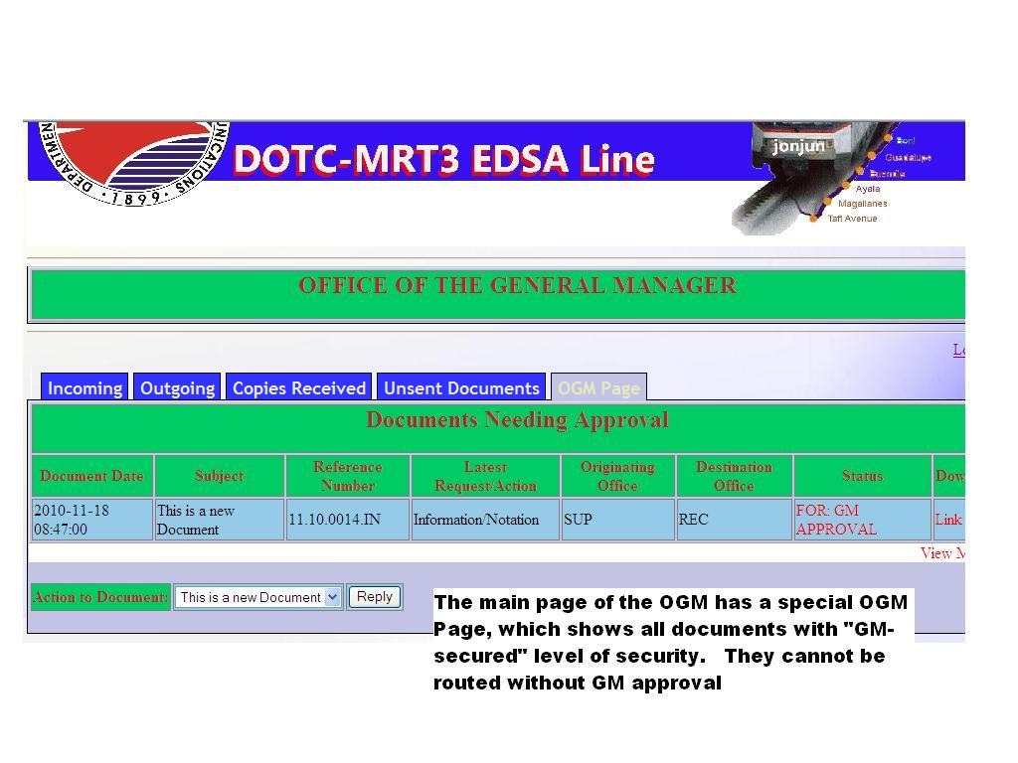

Slide 4
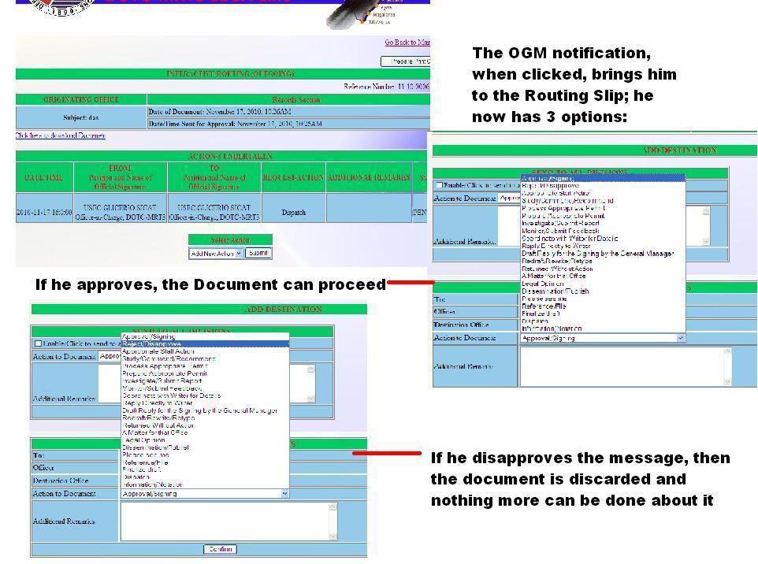

Slide 5
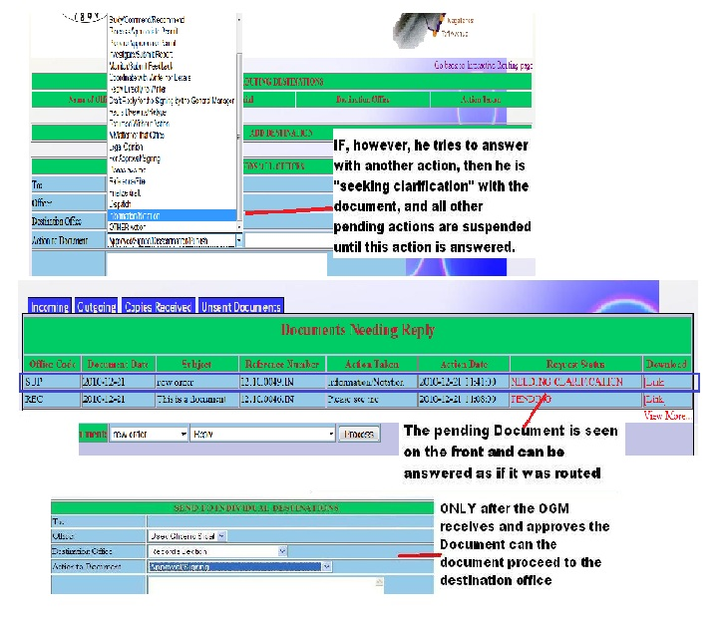

Slide 6
The General Manager Page
For additional information on this function, see the main manual

